Slide 1

Further Normalization I

Slide 2
What you will learn
1 Introduction
Nonloss Decomposition
First Normal Form (1NF)
Second Normal Form (2NF)
Third Normal Form (3NF)
Dependency Preservation
Boyce/Codd Normal Form(BCNF)
Procedure for Normalisation
Normalization/Denormalization

Slide 3
1.Introduction-example1
CustomerOrder(Ono,Cno,Company,Address,Odate,
Freight,Pno,Quantity)
  Ono : 订单代号
  Cno : 客户公司的代号
  Company : 公司名称
  Address : 客户的公司地址
  Odate订: 购日期
  Freight : 运货费
  Pno : 产品代号
  Quantity : 数量
Page <number>

Slide 4
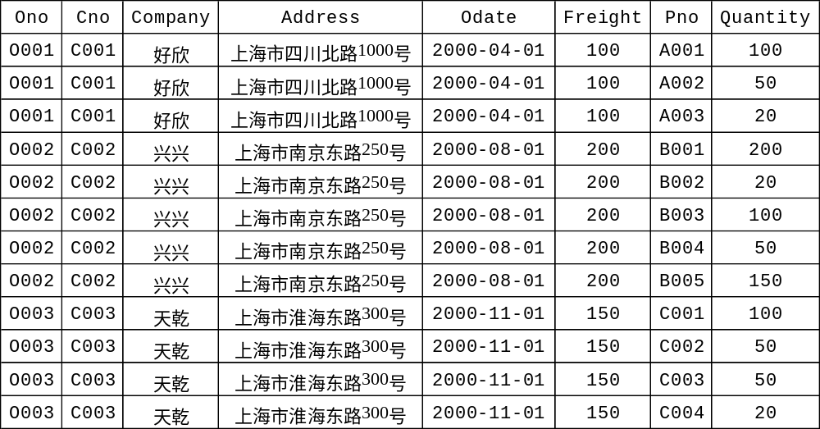
1.Introduction-example1
What is wrong with this design?
(redundancy,insert,delete,update)
Page <number>

Slide 5
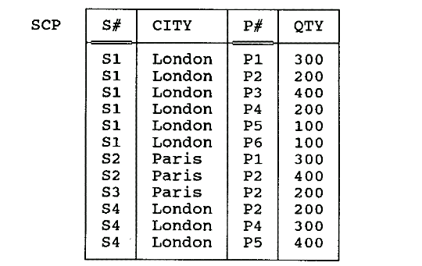
1.Introduction-example2
Fig. 11.1What is wrong with this design?
Page <number>

Slide 6
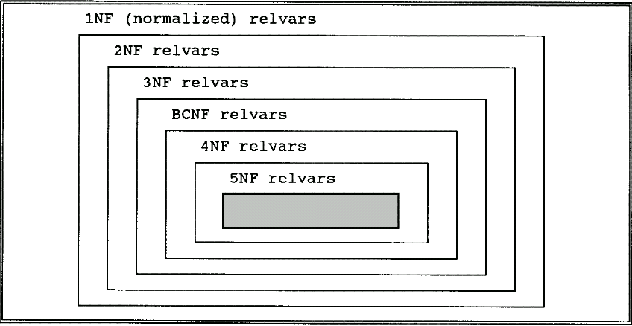
1. Introduction-Normalization(规范化)
Normalization is a progressive process of reducing a set of relations to a “more desirable” form (i.e. containing less redundancy).
The method of normalization is based on a progression through five increasingly “desirable” levels of forms (concerning some aspects of good design).
Fig. 11.2 Levels of normalization
Page <number>

Slide 7
1.Introduction-Decomposition(模式分解)
CustomerOrder(Ono,Cno,Company,Address,Odate,
Freight,Pno,Quantity)
  Order_c(Ono,Cno,Odate,Freight)
  Order_item(Ono, Pno ,Quantity）
  Customer(Cno,Company,Address)
SCP（S#，CITY，P#，QTY）
  S(S#，CITY）
  SP(S#，P#，QTY）
Page <number>

Slide 8
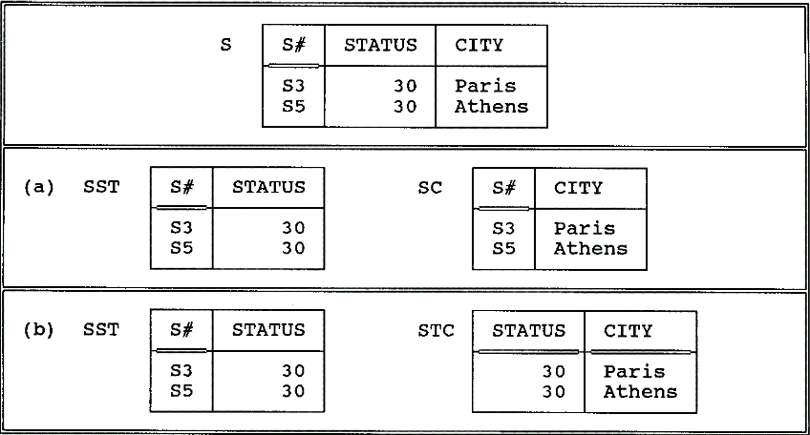
2. Nonloss Decomposition and Functional Dependencies
(无损分解和函数依赖)
Fig. 11.3 Sample value for relvar S and two corresponding decompositions
Page <number>

Slide 9
2. Nonloss Decomposition and Functional Dependencies…
The process of "decomposition" is really a process of projection.
How can we ensure that no information represented in the original relation is lost?
Heath’s theorem:
Given R with sets of attributes A, B and C, then if R satisfies the FD: A → B
then R is equal to the join of its projections on {A, B}and {A, C}.
Heath’s theorem does not explain why this is so.
e.g. Given S{S#, CITY, STATUS}
  S is equal to the join of {S#, CITY} and {S#, STATUS}
  -- non-loss decomposition
  S is not equal to the join of {S#, STATUS} and {CITY, STATUS}
Page <number>
Notes:
定义1：设关系模式R(U,F)分解为关系模式R1(U1,F1)，R2(U2,F2)，…，Rn(Un,Fn)，若对于R的任何一个可能的关系r，都有r=r1*r2…*rn，即r在R1,R2,…,Rn上的投影的自然连接等于r，则称关系模式R的这个分解是具有无损连接性的。

Slide 10
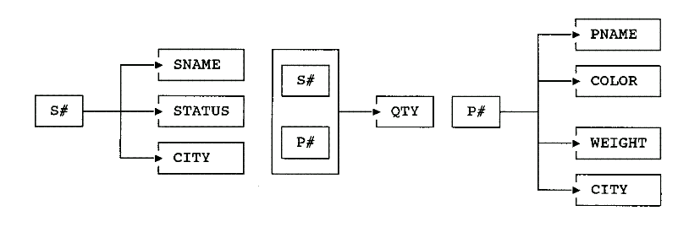
More on Functional Dependencies
Left-irreducible FDs:
  {S#,P#} → CITY
  S# → CITY √
FD diagrams:
Fig. 11.4 FD diagrams for relvars S, SP, and P
Page <number>

Slide 11
3. First Normal Form (1NF)第一范式
A relation is in 1NF if and only if all underlying fields contain atomic(scalar) values only.
A field contains multiple values
Course No.
Course Title
Student
Dept
C00061
DB 1
{Peter Brown,
Jenny Wong,
Neil Smith}
Accounts
Repeating groups
Course No.
Course Title
Student 1
Student 1 dept
Student 2
Student 2 dept
C00061
DB 1
Peter Brown
Accounts
Neil Smith
Accounts
C00023
Java
Jenny Wong
IT
Peter Brown
Computer
Page <number>

Slide 12
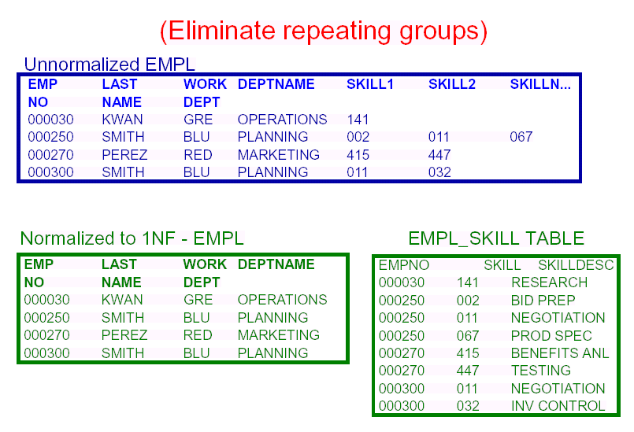
3. 1NF…
Page <number>

Slide 13
3. 1NF - Problems of 1NF
Primary Key (Supplier#, Part#)
Supplier#
Status
City
Part#
Quantity
S1
20
London
P1
1600
S1
20
London
P2
2000
S2
10
Paris
P2
500
S3
20
London
P3
3000
Insert - cannot insert the fact that a supplier is located in a particular city until supplier supplies at least one part
Delete - delete the value P3, and we also lose the information that S3 is located in London
Update - S1 appears in the table more than once, and we must change all of them -- Possibility of producing an inconsistent result.
Page <number>
Notes:
1. 插入异常(insertion anomaly)
这种异常是指当用户想要插入某一真实世界的实体数据时，还必须输入另一个真实世界中实体的数据。
举例来说，公司业务发展，新建了一个“家庭主妇团”的模式。但我要想往表里录入一个新的模式，还必须绑定地录入一个新的活动。
2. 删除异常(deletion anomaly)
这种异常是指当用户要删除某一真实世界的实体数据时，还必须删除另一个真实世界中实体的数据。
3. 修改异常(modification anomaly)
这种异常是指当用户要修改某个值的时候，同样的修改操作需要重复多次。

Slide 14
3. 1NF - Dependencies between Attributes
By analyzing a given relation, we can identify some dependencies between its attributes.
In principle, we want to make attributes independent of each other as far as possible, so that updating one attribute will have no impact on the others.
Supplier#
City
Quantity
Part#
Status
Page <number>

Slide 15
4. Second Normal Form (2NF)
A relation is in 2NF if and only if it is 1NF and every non-key field is irreducibly dependent on the primary key.
Primary Key (Supplier#, Part#)
Supplier#
Status
City
Part#
Quantity
S1
20
London
P1
1600
S1
20
London
P2
2000
S2
10
Paris
P2
500
S3
20
London
P3
3000
Note: City is a non-key field and only dependent on part of the primary key(i.e. supplier#). So this relation is not in 2NF.
Page <number>

Slide 16
4. 2NF-Solution to Problems
The solution is to replace the relation by two new relations (called One and Two)
One: Primary Key (Supplier#)
Two: Primary Key (Supplier#, Part#)
Supplier#
Status
City
Supplier#
Part#
Quantity
S1
20
London
S1
P1
1600
S2
10
Paris
S1
P2
2000
S3
20
London
S2
P2
500
S3
P3
3000
This revised structure overcomes all the problems sketched earlier, but:
  Insert - cannot insert the fact that a particular city has a status until a supplier is actually located in that city.
  Delete - delete the value S2, and we also lose the information that Paris has the status value 10.
  Update - Status value 20 appears in the table more than once.
Page <number>

Slide 17
4. 2NF - Procedure to Get 2NF
Given a relation R as follows:
R(A, B, C, D) with Primary Key (A, B)
FD: A → D
Replace R by the two projections R1 and R2 as follows:
R1(A, D) with Primary Key A
R2(A, B, C) with Primary Key (A, B)
Foreign Key A references R1
Page <number>

Slide 18
5.Third Normal Form (3NF)
A relation is in 3NF if and only if it is 2NF and all non-key fields are mutually independent.
One: Primary Key (Supplier#)
Two: Primary Key (Supplier#, Part#)
Supplier#
Status
City
Supplier#
Part#
Quantity
S1
20
London
S1
P1
1600
S2
10
Paris
S1
P2
2000
S3
20
London
S2
P2
500
S3
P3
3000
Note: Relation Two is in 3NF (with only one non-key field), but relation One is not in 3NF because Status is dependent on City (both are non-key fields)
Page <number>

Slide 19
5.3NF - Converting 2NF into 3NF
We can now normalize relation One into two new relations (called three and four), which both are in 3NF.
Three: Primary Key (Supplier#)
Four: Primary Key (City)
Supplier#
City
S1
London
City
Status
London
20
S2
Paris
Paris
10
S3
London
Higher Normal Forms (e.g. 4NF and 5NF) do exist, but they are mainly of interest in academic societies rather than in the practical applications of database design.
Page <number>

Slide 20
5. 3NF - Procedure to Get 3NF
Given a relation R as follows:
R(A, B, C) with Primary Key A
FD: B → C
Replace R by the two projections R1 and R2 as follows:
R1(B, C) with Primary Key B
R2(A, B) with Primary Key A
Foreign Key B references R1
Page <number>

Slide 21
6. Dependency Preservation
(保持函数依赖)
We expect that the projections are independent of one another, in the following sense: Update can be made to either one without regard for the other.
The idea that the normalization procedure should decompose relvars into projections that are independent has come to be known as dependency preservation.
In the process of decomposing, no FDs should span two relvars. – enforcing these constraints is very difficulty.
Projections R1 and R2 of relvar R are independent if and only if:
  Every FD in R is a logical consequence(推论) of those in R1 and R2, and
  The common attributes of R1 and R2 form a candidate key for at least one of the pair.
  (R1和R2的公共属性至少组成它们之中的一个候选码)
Page <number>

Slide 22
6. Dependency Preservation…
SECOND（ S#,STATUS,CITY ）
S#
CITY
STATUS
Decomposition
SC（S#，CITY）
CS（CITY，STATUS）
dependency preservation √
Page <number>

Slide 23
6. Dependency Preservation…
SECOND（ S#,STATUS,CITY ）
dependency preservation╳
SC（S#，CITY）
SS（S#，STATUS）
Updates to either of the two projections must be monitored to ensure that the FD CITY→ STATUS is not violated (if two suppliers have the same city, then they must have the same status).
Page <number>

Slide 24
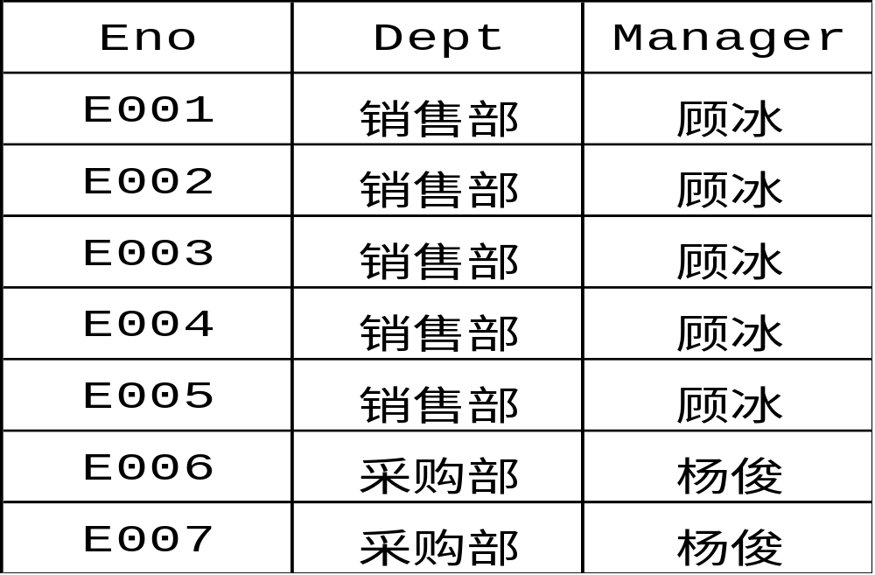
Example
EMP（Eno,Dept,Manager） with FDs
Eno→Dept，Dept→Manager
Page <number>

Slide 25
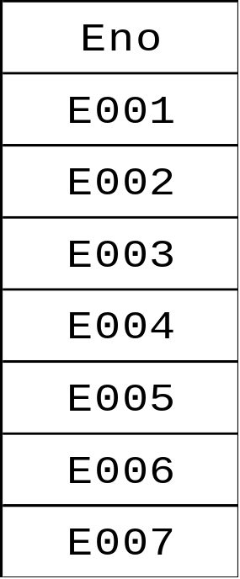
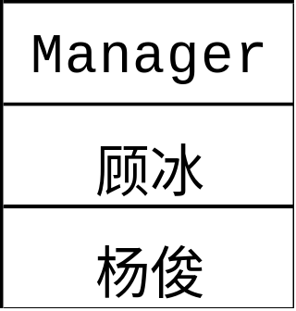
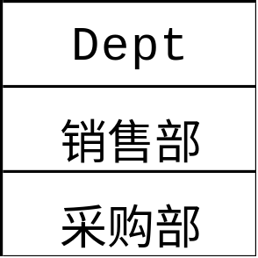
Example-Decomposition1
E D M
规范化程度很高，但是却丢失了原来关系模式中的信息
Page <number>

Slide 26
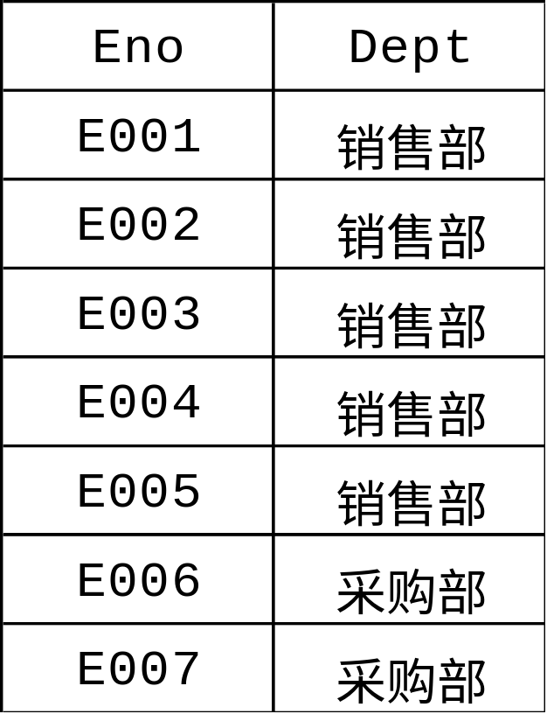
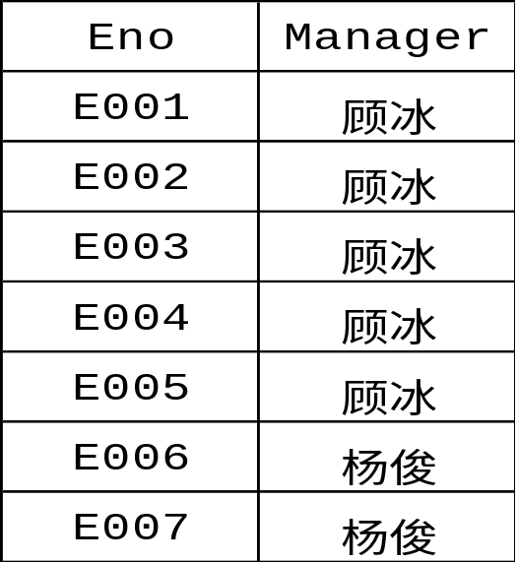
Example-Decomposition2
ED EM
具有无损连接性
没有保持函数依赖
部门的经理是谁？- Join
当雇员“E001”从销售部门转到采购部门时，需同时修改ED中的（“E001”，“销售部”）元组和EM中的（“E001”，“顾冰”）元组。
Page <number>
Notes:
关系模式的一个分解可能是保持函数依赖的，可能是具有无损连接性的，也可能是既具有无损连接性又保持函数依赖的。

Slide 27
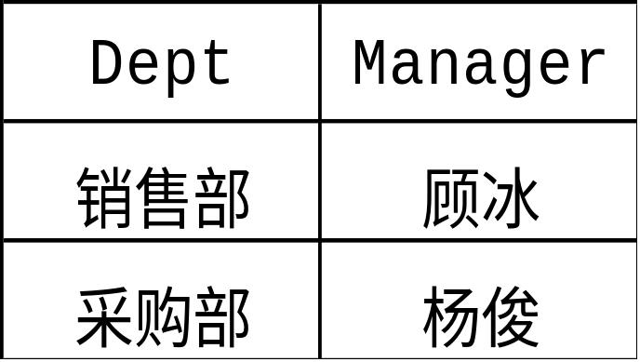
Example-Decomposition3
部门的经理是谁？
当雇员“E001”从销售部门转到采购部门…..
ED DM
既具有无损连接性又保持了函数依赖
Page <number>

Slide 28
7. Boyce/Codd Normal Form
Boyce/Codd Normal Form (BCNF): a relation is in BCNF if and only if every non-trivial, left-irreducible FD has a candidate key as its determinant.
In other words the only arrows in the dependency diagram are arrows out of candidate keys AND no other arrows.
Page <number>

Slide 29
3NF vs. BCNF
3NF and BCNF are equivalent if the combination of the following
conditions does not occur for a relation that
1. had two (or more) candidate keys, such that
2. the two keys were composite, and
3. they overlapped (i.e. at least one attribute in common)
e.g. S (S#, SNAME, STATUS, CITY)
CANDIDATE KEY (S#)
CANDIDATE KEY (SNAME)
S#
CITY
SNAME
STATUS
Page <number>

Slide 30
Not 3NF Not BCNF
e.g. SSP (S#, SNAME, P#, QTY)
CANDIDATE KEY (S#, P#)
CANDIDATE KEY (SNAME, P#)
S#
SNAME
P#
QTY
S#
P#
S1
S1
S1
S1
Smith
Smith
Smith
Smith
P1
P2
P3
P4
300
200
400
200
QTY
SNAME
{S#, P#} → SNAME
But SNAME is not irreducibly dependent on {S#, P#}
Because S# → SNAME
Page <number>

Slide 31
Example
S
T
STJ（S，T，J）
S:学生 T:教师 J:课程
J
CANDIDATE KEY :
  {S,J}
  {S,T}
结论：不属于BCNF
Decomposition :
ST{S，T}
TJ{T，J}
∈BCNF
Page <number>

Slide 32
Example
EXAM（S，J，P）
S:学生 J:课程 P:名次
S
J
P
S
J
P
候选码：{S，J} 和{J，P}
EXAM∈BCNF
Page <number>

Slide 33
8.Procedure for Normalisation
1) take projections of 1NF relation to eliminate reducible FDs -- giving a set of 2NF relations
2) take projections of these 2NF relations to eliminate transitive FDs -- giving a set of 3NF relations
3) take projections of these 3NF relations to eliminate FDs in which the determinant is not a candidate key -- giving a set of BCNF relations
4) take projections of these BCNF relations to eliminate MVDs which are not also FDs -- giving a set of 4NF relations
5) take projections of these 4NF relations to eliminate JDs which are not implied by candidate keys -- giving a set of 5NF relations
Page <number>

Slide 34
9. Normalization/Denormalization
Are Normal Forms a wholly “good thing”?
  Remove a number of serious problems resulting from redundant information.
  Can be achieved by following a general procedure.
  Decomposition may lead to poor performance (too many small tables).
  Decomposition may make it easy to break semantic constraints although constraints of referential integrity could help.
Page <number>

Slide 35
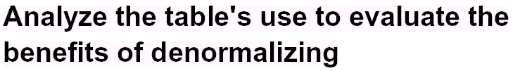
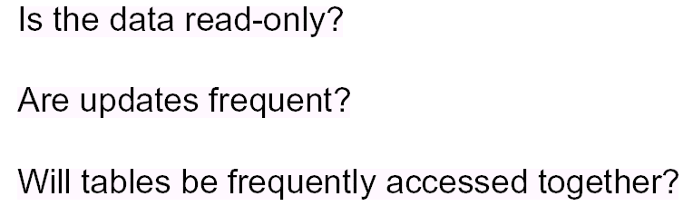
Questions answer
Page <number>

Slide 36
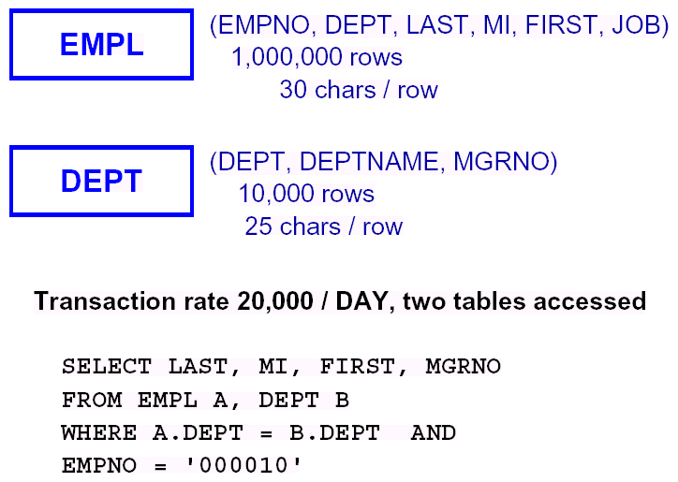
Normalization/Denormalization Example
Page <number>

Slide 37
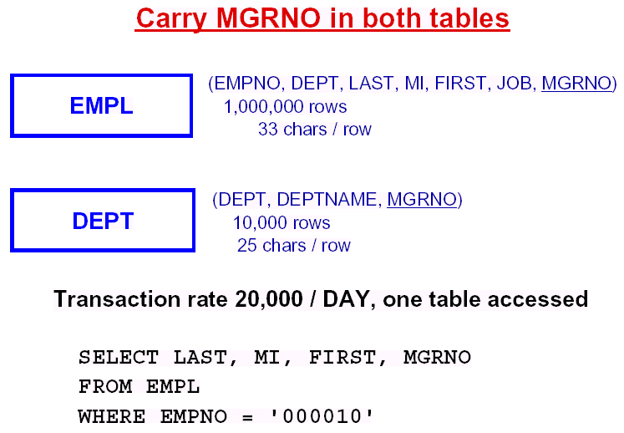
Normalization/Denormalization Example…
Page <number>

Slide 38
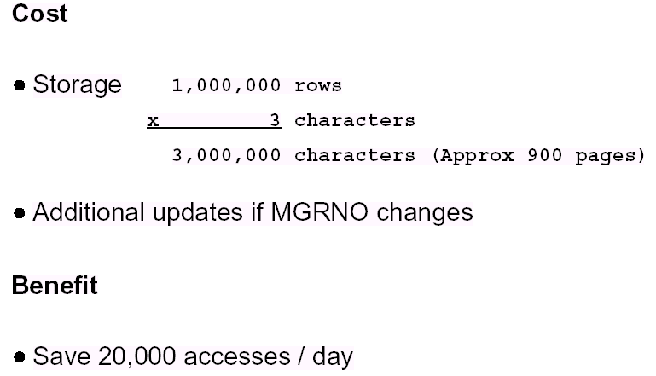
Costs and Benefits of Denormalization
Page <number>

Slide 39
Exercises
For each of the following relation schemas and sets of functional dependencies:
R(A,B,C,D) with FDs: AB→ C, C→ D, and D→ A
R(A,B,C,D) with FDs: B→ C, and B→ D
Do the following:
Indicate all the 2NF/3NF/BCNF violations;
Decompose the relations, as necessary, into collections of relations that are in 2NF/3NF/BCNF.
Answer: both of them are in INF.
Page <number>

